Slide 1


Hotel Reservation Booking Cancellation Prediction
Presented by: Pranav Dange and Vabhavi Tickoo
IS 517 : Methods of Data Science
Renee Hendricks

Slide 2


TABLE OF CONTENT
Background
Past Studies and Limitations
Project Objectives and Dataset
Proposed Methods
Exploratory Data Analysis
Data Cleaning
Models Analysed
Results and comparison
Limitations
Conclusion
Q&A
Feature Selection

Slide 3
BACKGROUND
Boost in hotel operations
Till 2022, significant raise in hospitality business
Anticipating cancellations can help manage hotels
Previous studies predicted cancellations using different algorithms
Performance dependent on variables
Leveraging previous dataset for choosing best variables.

Slide 4
PAST STUDIES AND LIMITATIONS
Studies have attempted to predict cancellations using various algorithms, including decision trees, random forest, and logistic regression.
Limitations of earlier research was the use of small datasets, which may not accurately represent the diverse range of factors that contribute to cancellations.
The limited scope of previous research has resulted in varied outcomes and limited ability to generalize findings across different contexts.
The lack of focus on specific features that have a high correlation with cancellation, leading to less accurate predictions.

Slide 5
PROJECT OBJECTIVE AND DATASET
OBJECTIVE
DATASET
The objective of our project is to develop an accurate prediction model for hotel reservation cancellations using our dataset.
To achieve this, we will perform exploratory data analysis and pre-process the data, including encoding variables with object datatype and dropping redundant variables.
We will only use variables that have a significant impact on the prediction.
We will test different models and tune them to improve their accuracy.
Our dataset is the "Hotel Reservations Classification Dataset" from Kaggle, which includes 36275 records of hotel reservations.
The dataset contains various attributes.
Both categorical and numerical data are included, which will be further processed according to our data analysis.

Slide 6
PROPOSED METHOD
Our proposed method for predicting hotel reservation cancellations will consist of several steps, including data preprocessing, feature selection, model selection, and model evaluation.
First pre-process the data
Next, we performed feature selection
Evaluate several machine learning algorithms
After selecting the best algorithm, we will tune its hyperparameters
Finally, we will evaluate the performance of our model using various metrics

Slide 7

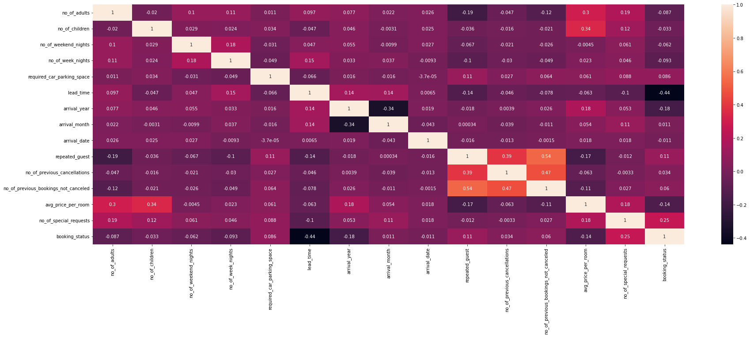
EXPLORATORY DATA ANALYSIS
Confusion matrix to analyze the correlation between the variables

Slide 8
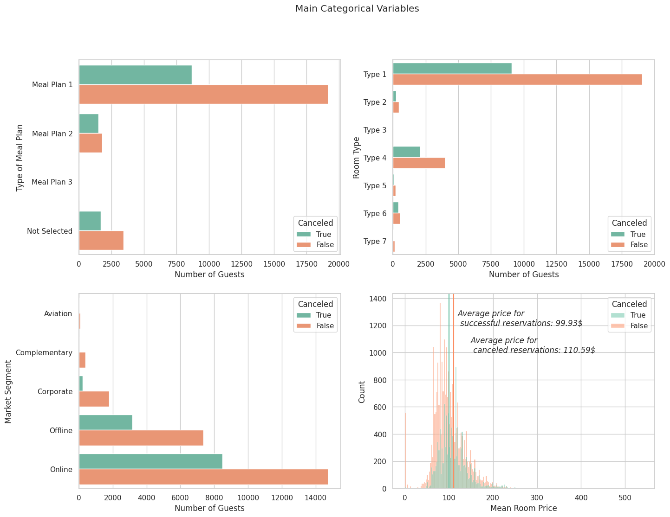
EXPLORATORY DATA ANALYSIS
Upon analysis, we observe that:
The proportion of canceled bookings remains relatively stable over time.
Rooms of type 6 have a higher cancellation rate compared to other room types.
The proportion of offline and corporate cancellations is relatively lower compared to online cancellations.
Canceled bookings have a higher average price of 110.59 USD compared to successful bookings.

Slide 9
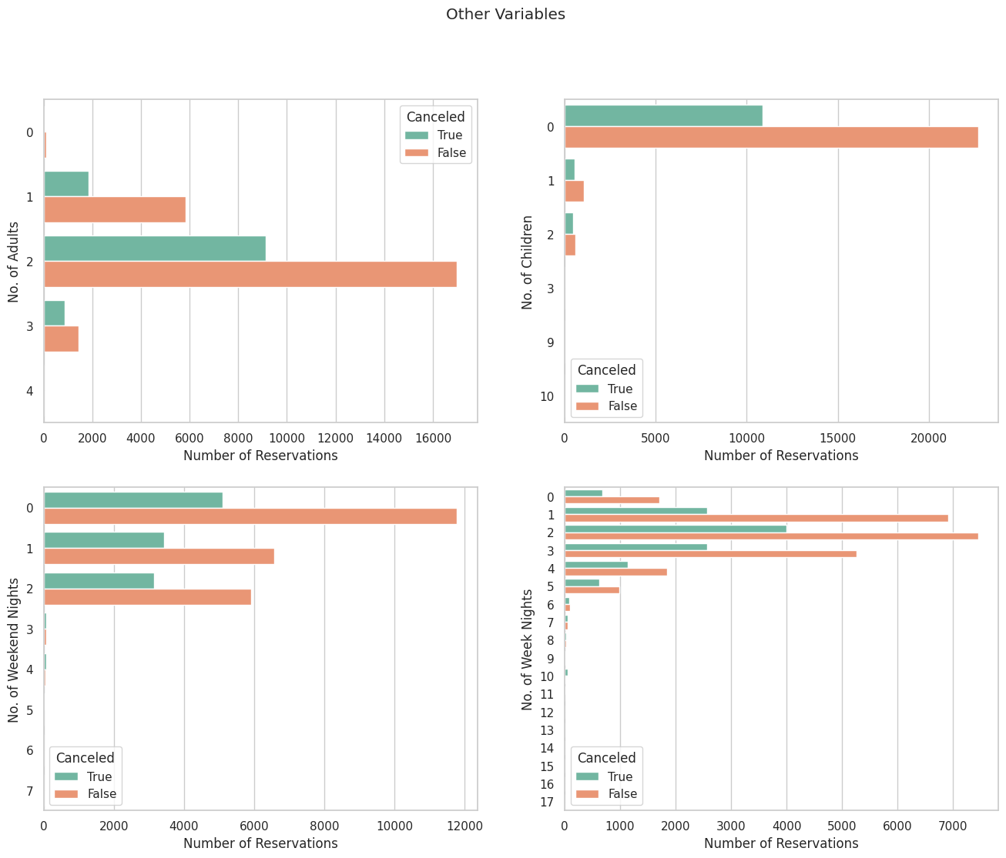
EXPLORATORY DATA ANALYSIS
We also found that:
The reservations for 3 adults have a higher cancellation rate.
Similarly, reservations with two children also have a higher likelihood of cancellation.
Our analysis suggests that there is a positive correlation between the number of weeknights booked and the probability of cancellation.

Slide 10
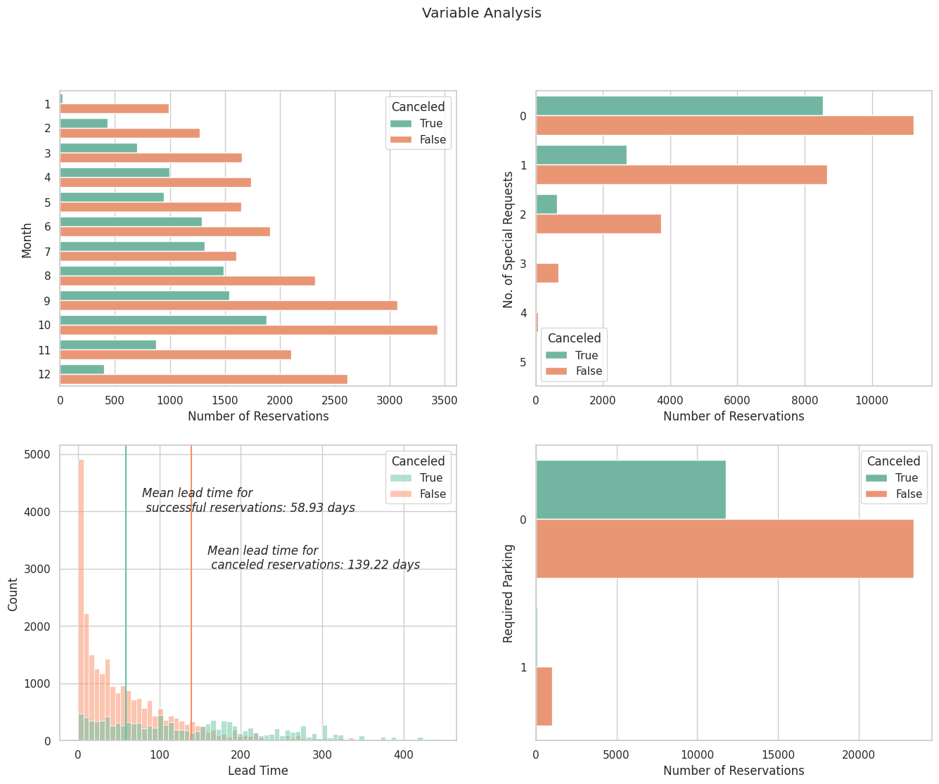
EXPLORATORY DATA ANALYSIS
Observations:
The proportion of cancellations decreases during winter months.
There seems to be an inverse relationship between the number of special requests and cancellations.
Reservations with a longer lead time are more likely to be canceled.
Reservations that require parking have a very low rate of cancellations.

Slide 11
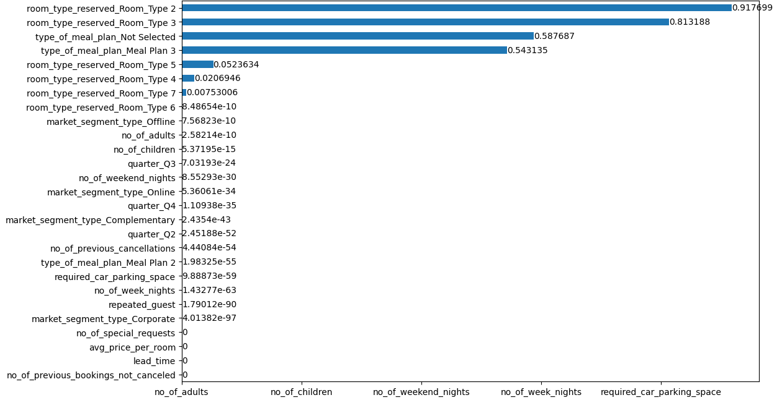
DATA CLEANING AND FEATURE SELECTION
We pre-processed our data by dropping the unnecessary columns like booking id and arrival year and converted arrival month to quarters and encoding categorical variables.
In feature selection we calculated the chi-squared statistic for each feature to identify the most relevant features. The results were plotted as a horizontal bar chart, with features sorted in ascending order of p-values.
Next, we removed the less important features, such as room types and meal plans that were not selected, to reduce the dimensionality of the dataset. This step was necessary to prevent overfitting and improve model performance.
Features dropped: booking_id, arrival_year, arrival_date, arrival_month, room_type_reserved_Room_Type 2, room_type_reserved_Room_Type 3, type_of_meal_plan_Not Selected, type_of_meal_plan_Meal Plan 3, room_type_reserved_Room_Type 5

Slide 12
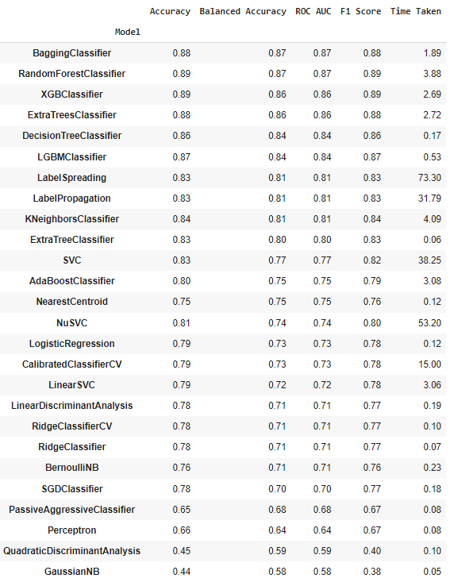
MACHINE LEARNING MODELS
Initially we just encoded the categorical features and did an 80:20 split and used lazy predict to get an overview of how the different models would perform.
Out of the 26 models we analysed the best performing methods were Random Forest Classifier and XGBClassifier which had accuracy of around 89%and Balanced Accuracy of around 87%.
So, our approach was to fine tune these models.

Slide 13
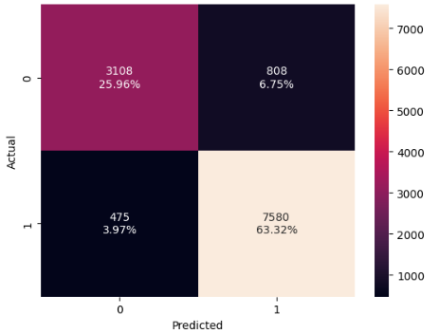

MACHINE LEARNING MODELS
We performed different data pre-processing techniques like dropping the columns which and low correlation on the result variable and even performed over sampling on the data because there was a skew in the cancellation and non-cancellation value. However, we were not able to improve on the 89% Accuracy of the model.

Slide 14
MACHINE LEARNING MODELS
First columns names are converted to lowercase, and unnecessary columns such as booking ID, arrival year, and arrival date are dropped because it did not have impact on the predicted value based on the confusion matrix we analysed in our EDA.
We created a new column named 'quarter' using the arrival month column values, and the arrival month column is dropped.
We encoded categorical variables using one-hot encoding, and the target variable is separated from the feature set.
We performed Chi-square test to select the most significant features for the classification task.
Features with high p-values are dropped.
As our count was not balanced for the cancelled and not cancelled data, we performed SMOTE oversampling for our Random Forest Classifier.

Slide 15
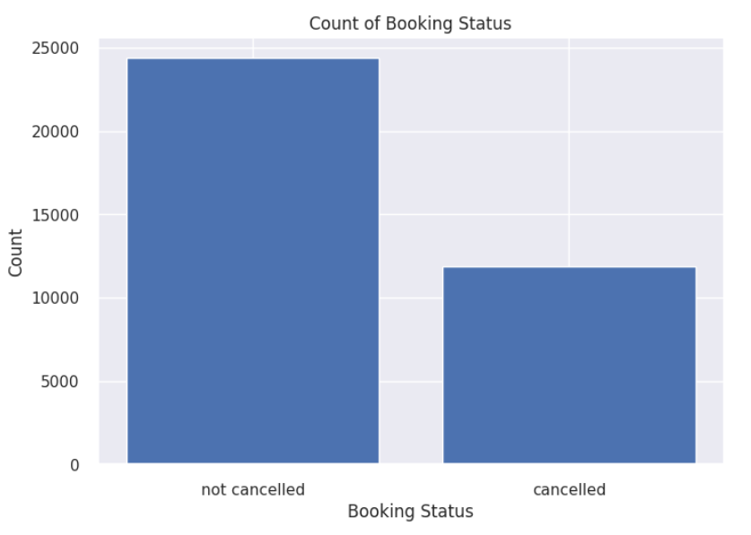
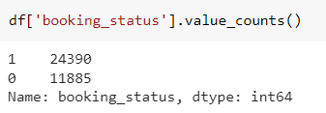
MACHINE LEARNING MODELS
We used SMOTE to address the class imbalance problem in the dataset.

Slide 16
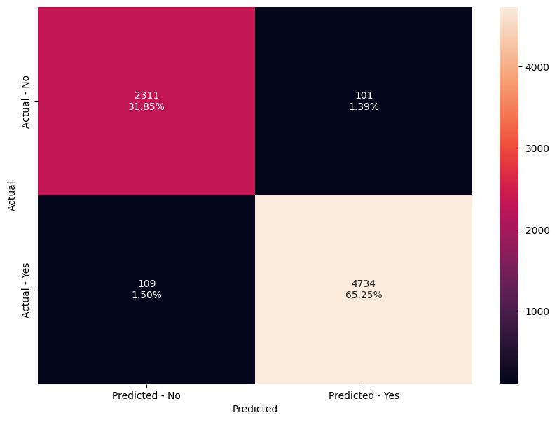
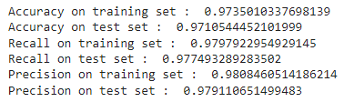

MACHINE LEARNING MODELS
Result of our Random Forest Classifier.

Slide 17
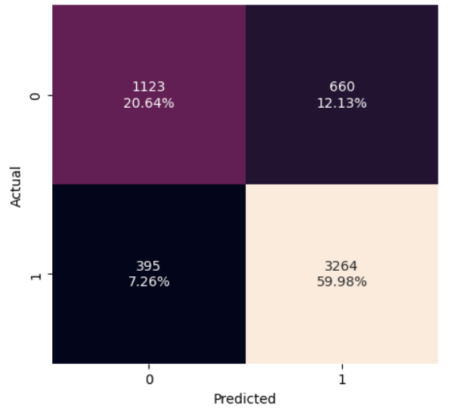
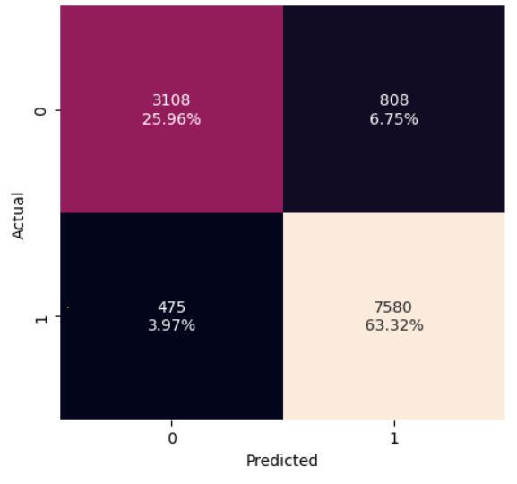
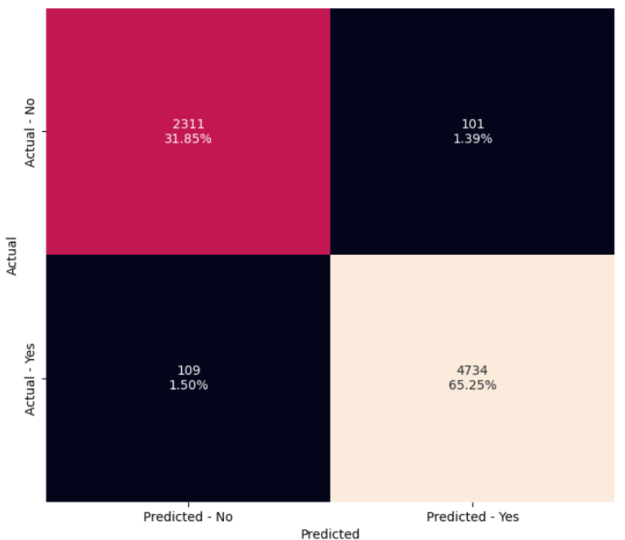



RESULT COMPARISONS
Logistic Regression
XGBoost
Random Forest

Slide 18
RESULT COMPARISONS
Model | Accuracy | F1 Score | Precision | Recall
Logistic Regression | 73 | 78 | 76 | 79
Naive Bayes | 67 | 76 | 51 | 61
SVM Classifier | 76.01 | 76 | 75 | 78
Decision Tree Classifier | 84 | 86 | 84 | 89
XGBoost | 89.29 | 92.19 | 90.37 | 94.10
Random Forest | 97.10 | 97.83 | 97.91 | 97.75

Slide 19
LIMITATIONS
Factors outside our control could impact prediction accuracy
Limited dataset in terms of time period and region
Dataset may contain errors or inconsistencies
Model may not be generalizable to other hotel properties
Limited by quality and quantity of data available
Additional variables may impact cancellations that are not captured in our dataset
Limitations in algorithm performance and feature selection.

Slide 20
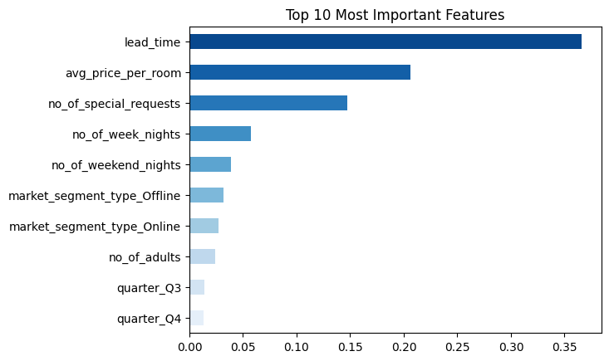
CONCLUSION
1. Reservations exhibit cancellation patterns where high lead time is a strong predictor while previous stay or special requests such as car space decrease cancellation probability.
2. Lead_Time, Avg_price_room, and Number of special requests are the top 3 variables for predicting cancellations.
3. The Random Forest model performs the best with a 97.10% accuracy rate.
4. Lead_Time is identified as the most critical variable, followed by the number of special requests.
5. The number of nights is also a significant factor, but the model assigns less importance to it.
6. Market segments also impact cancellation probability.

Slide 21
References
Dataset: https://www.kaggle.com/datasets/ahsan81/hotel-reservations-classification-dataset
https://ieeexplore-ieee-org.proxy2.library.illinois.edu/stamp/stamp.jsp?tp=&arnumber=9299011
https://reader.elsevier.com/reader/sd/pii/S2352340918315191?token=151498555C6714B58A822BC9AECD1115C6CCD0604F26D5390A6BE10D712D9CB2C8281231F7348830DBF401C5FD0513F6&originRegion=us-east-1&originCreation=20230323003607
https://ia-institute.com/wp-content/uploads/2021/07/IAI-Journal_2.2021.pdf
https://www.kaggle.com/code/raphaelmarconato/hotel-reservations-eda-balancing-and-ml-93-4

Slide 22

QUESTIONS?

